Slide 1



Ed Study Groups
A platform that allows students to study online together
Name: Nirali Thakkar
CS 6750: Human-Computer Interaction
Professor: Dr. David Joyner
College of Computing, Georgia Tech

Slide 2
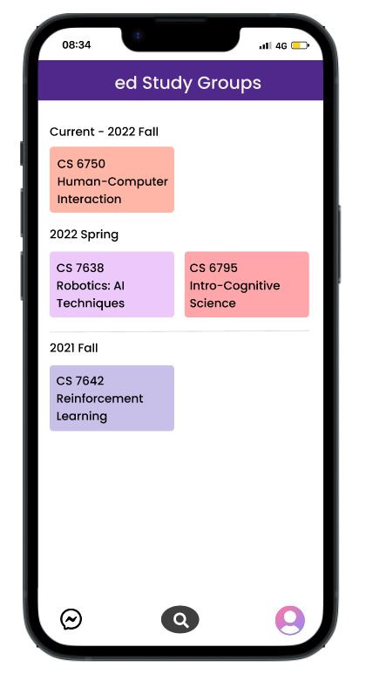

Dashboard
Dashboard
Ed Study Groups: an extension of Ed Discussion
The dashboard shows courses from each semester
The icons below represent messages, Connect, and account settings
Messages – saves chat with friends, Connect – connects with a study partner, Account settings – change username or display picture
Figure 1

Slide 3
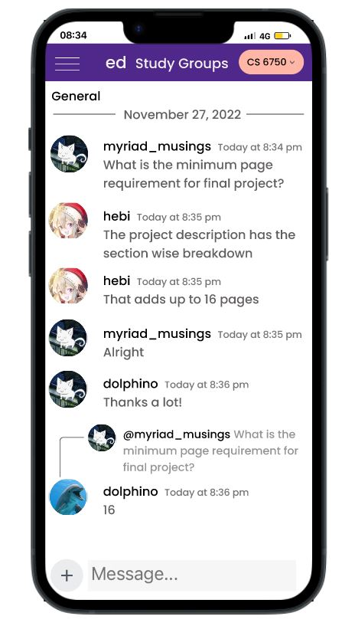
Class CS 6750
Switch to different course from the drop-down menu
Figure 2 shows the chat discussion from the General section
Survey shows that 75% participants are willing to use customized avatars and usernames
No user is completely anonymous as their accounts are authenticated with the university
Figure 2

Slide 4
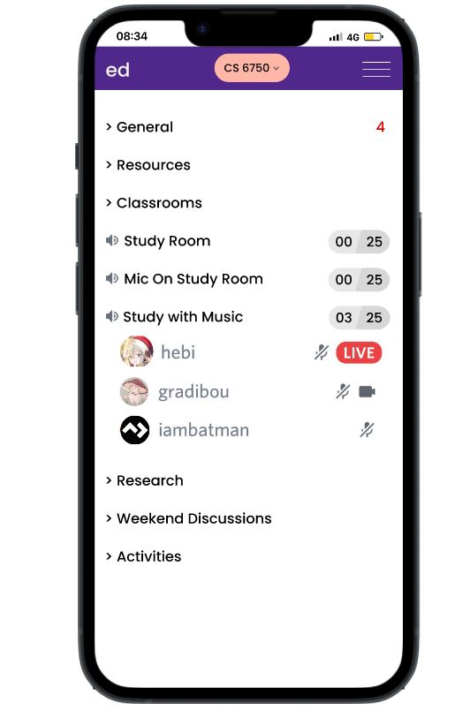



Class CS 6750 Navigation Bar
Classrooms – students can watch video lectures together, teachers can conduct office hours
Study rooms – silent studying, discussing and studying, solving assignments listening to music
Research section for finding a partner to collaborate and Activities section for game nights and watching movies/tech documentaries together
Figure 3

Slide 5
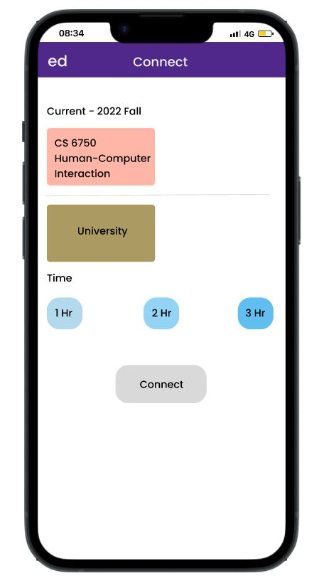
Connect feature
Connects with a study partner from the same course or University to study together
Based on the Pomodoro Studying Technique, one can select the number of hours to study from 1 to 3
Figure 4

Slide 6
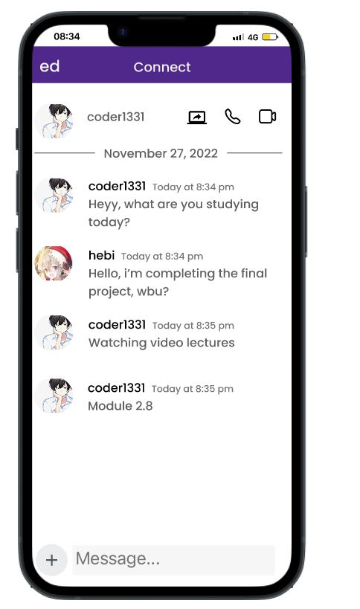
Connected with a student from CS 6750
Figure 5 shows the chat when you connect with a student from CS 6750
You can screenshare or join them on call and update each other with your study progress
Figure 5

Slide 7
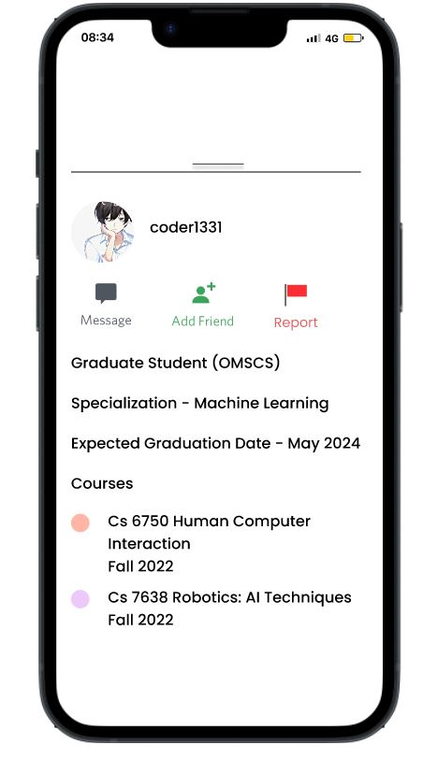
Profile Information
Profile information contains the courses taken and expected graduation date
For online programs, expected graduation date can help students meet their friends on graduation day
Figure 6

Slide 8
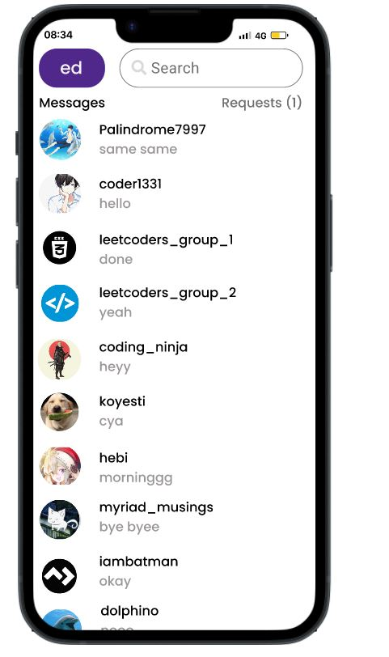
Messages
Figure 7 shows the chats with friends, friend requests, and search bar to search for a friend
Figure 7

Slide 9
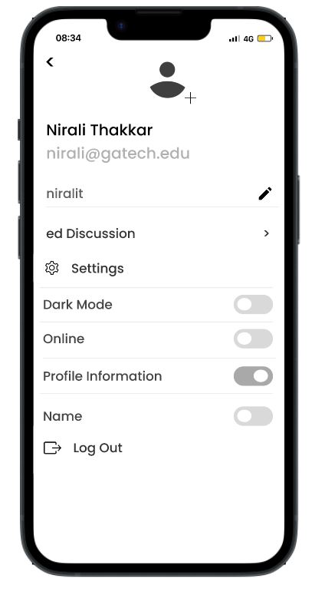
Account Settings
Flexibility to switch to Ed Discussion
Choose to show real name and profile information (courses taken and graduation date)
Change avatar, username
Figure 8

Slide 10
Conclusion
Survey shows that 54 out of 60, that is, 90% participants are willing to use this application
Further research will be conducted on students who have not used Ed Discussion before
Live Demo - Link
Evaluation results and prototype design principles explained in detail - Link

Slide 11

Thank You!

